Slide 1
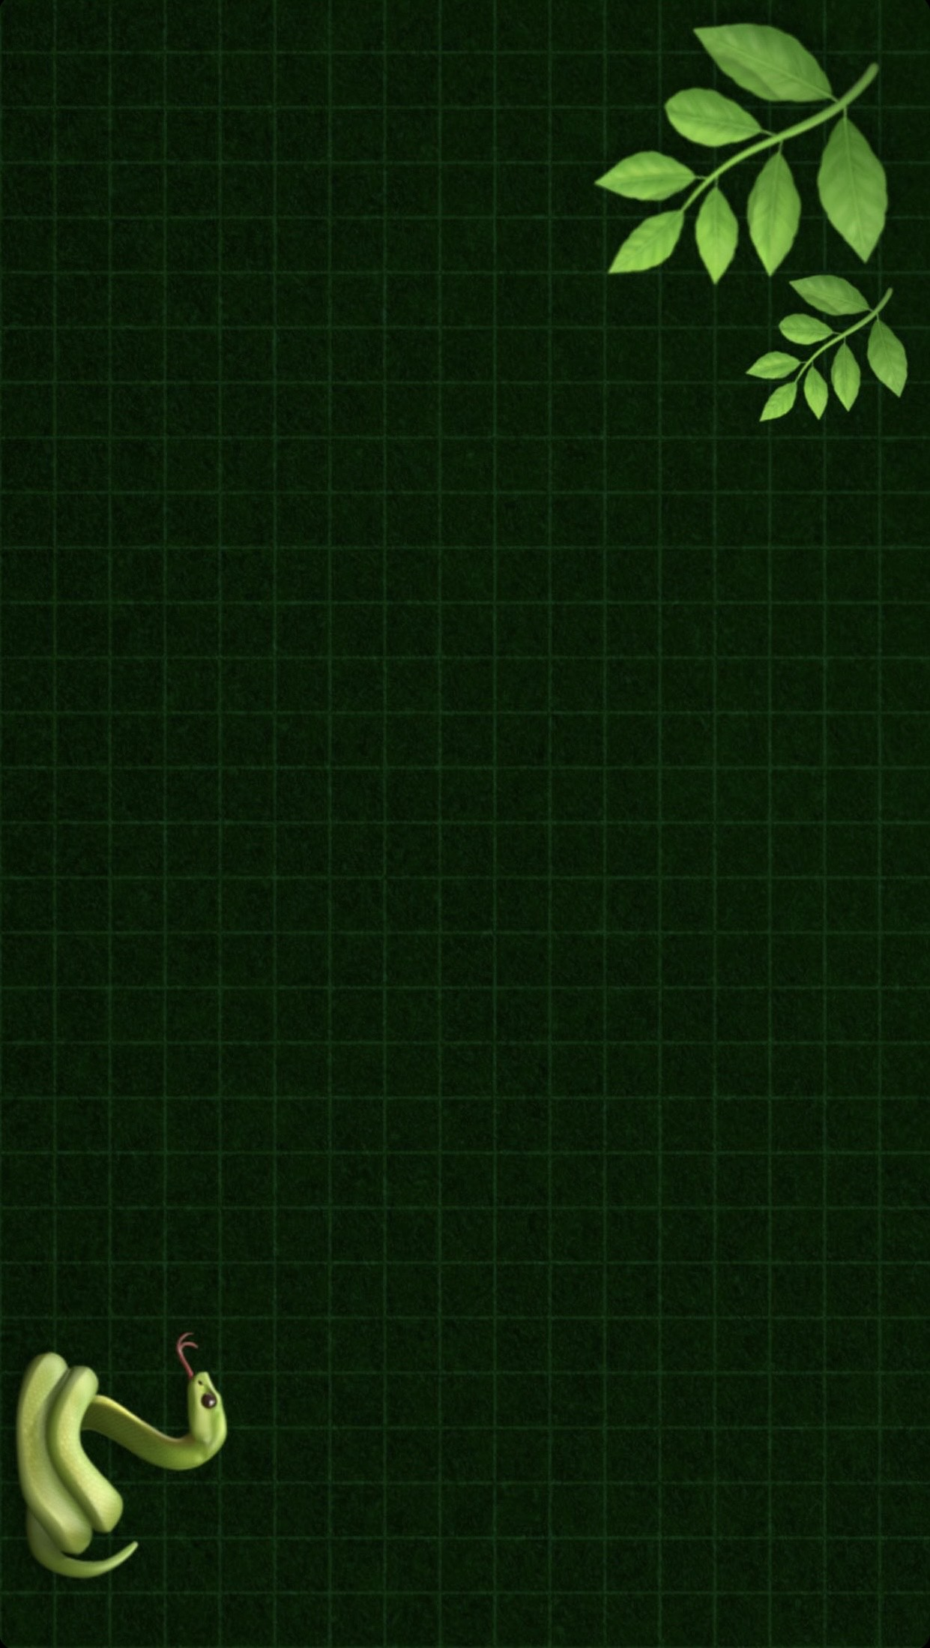
Rattlesnake Rush
Created by:
Raja Abdullah Shafique, Lhakpa Tamang,
Amina Khan, Destiny Otto, Vanesa Efremova;

Slide 2
Meet the team
print Lhakpa ():
Main Coder
print Raja ():
Main Coder
print Destiny ():
Sound and Graphic Creator
print Amina ():
Documentation Creator, Organizer
print Vanesa():
Nominator, Presentation creator
def

Slide 3
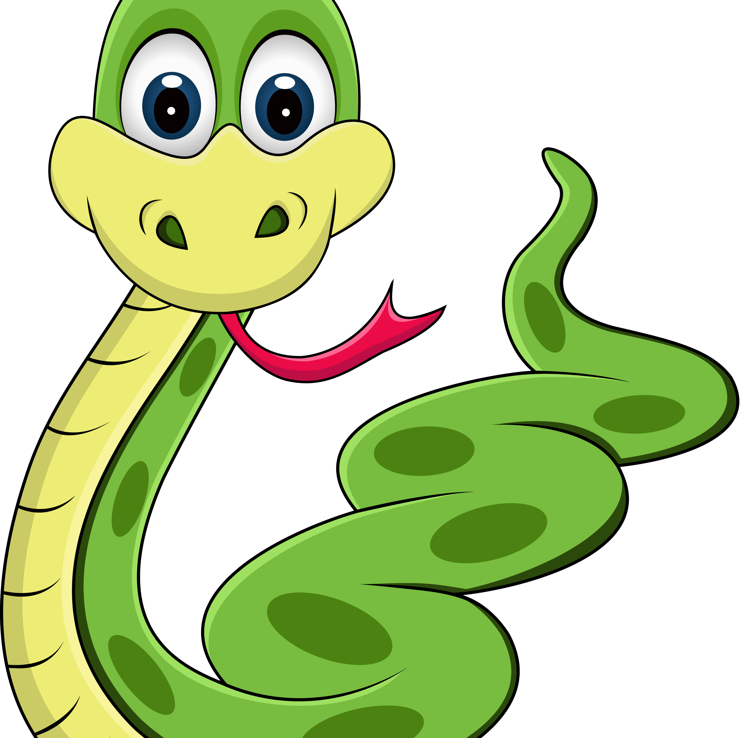
Introduction
The furious and hungry snake named Slyther is on the hunt for delicious food in the forest. Slyther has insatiable desire for the mouthwatering apple because they are not only filling him up but also making him grow. However, on the way to the hunt he must face some obstacles like the life-threatening walls and his own tail which can stop him from getting what he wants.

Slide 4
Game overview
With this game we wanted to create something for all generations, simple but addicting. The main goal of this game is to lead the snake through a small play area while avoiding collisions with the surrounding walls and the snake's own tail which grows longer while feeding it.

Slide 5
The three rules of the game :
The snake moves continuously in the chosen direction by the player;
When the snake consumes apples, it grows longer;
The game will continue until the snake touches the walls or its own tail;

Slide 6

Our main classes:
Game
Snake
Apple

Slide 7
Development process
Game concepts, objectives and features;
Game board, snake and apple sizes;
Implementing apple generation;
Handaling Collison outcome;
Managing scoring , game progression and conditions;
Trying out different graphics;
Music and sound effects;

Slide 8
Issues/Errors
One of our main issues
was the design of the snake, adding details and creating the final design which extends every time the snake eats an apple.

Slide 9
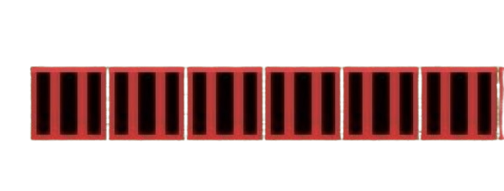


Progression and
fixing on our issue
First design
Final design

Slide 10
Enjoy the demo of our game.

